Slide 1




MAJOR PROJECT
PUBLIC TRANSPORT OPTIMIZATION
Enhancing Efficiency and Reducing Wait Times

Slide 2
OUR TEAM
1.
Kevin Gandhi
2.
Harsh Mishra

Slide 3
PROBLEM STATEMENT
Increasing commuter wait times and uneven passenger load across routes.
Some routes are overcrowded, while others are underutilized.
Current schedules don’t align well with actual passenger demand.
Goal: Use data-driven optimization to improve scheduling and efficiency.

Slide 4
APPROACH
Data Collection: Gathered data on routes, schedules, and passenger load.
Data Cleaning: Removed duplicates and formatted time and route details.
Analysis: Identified peak hours and low-demand routes.
Optimization: Used Excel Solver / Python to adjust departure times and fleet allocation.
Visualization: Built Power BI / Tableau dashboards to compare current vs optimized schedules.

Slide 5
EDA (EXPLORATORY DATA ANALYSIS) HIGHLIGHTS
Tools Used: Excel, SQL, Python,Power BI
Methodology:
Aggregated ridership data by route and time slot.
Analyzed average load and utilization rates.
Key Insights:
Peak demand observed in vishakapatnam.
Guntur-Hyderabad and Kadapa Hyderabad had maximum passenger load.
20% of routes showed below 40% utilization.
Potential to reduce total fleet usage by 10–15% through optimization.

Slide 6
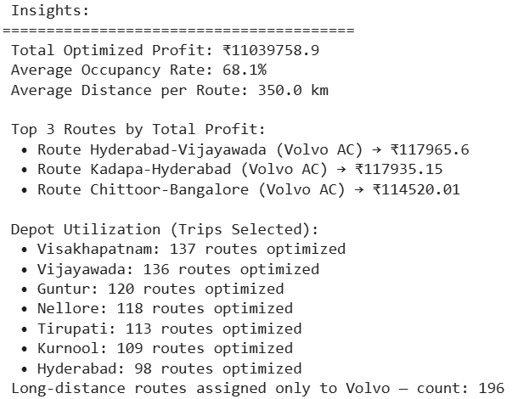
MODEL RESULTS
Optimization Method: Python(Linear Optimization)
Objective: To increase the profit.
Results: Linear Progession Model

Slide 7
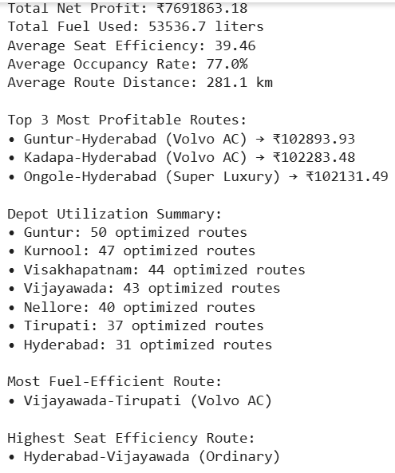
MODEL RESULTS
Results: LPproblem

Slide 8
MODEL RESULTS
Compare

Slide 9
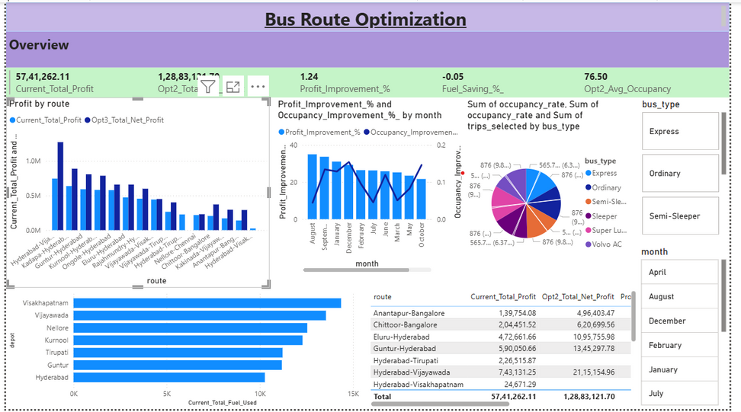
DASHBOARD DEMO
Dashboard Features:
Route utilization comparison (Before vs After)
Peak hour heatmaps
Passenger trend charts
Bus allocation optimization summary
Tool Used: Power BI / Tableau

Slide 10
RECOMMENDATIONS
Adjust frequency of buses on high-demand routes during peak hours.
Reduce underutilized services during off-peak times.
Implement a phased rollout of optimized schedules.
Integrate real-time passenger data for continuous improvement.

Slide 11
THANK
YOU

